Slide 1
Using Deep Learning to Detect Multiple Cancers From a Blood Test
Steven Qu
—
Oak Ridge High School
Oak Ridge, TN

Slide 2
Cancer and Traditional Screening Tests
A disease that causes uncontrolled cell division
Metastasis: process of tumor spreading
Traditional screening tests are expensive, invasive, and limited to a single cancer type
Mammograms
Colonoscopies
Endoscopies
Cervical Cytology

Slide 3
Blood Tests
Non-invasive
Economical
HeiScreen: Breast cancer screening blood test
CancerSEEK: Detects 8 cancer types simultaneously

Slide 4
CancerSEEK
Blood test developed by Johns Hopkins
Data: 1817 individuals (1005 with clinically detected cancer, 812 healthy)
39 protein biomarker concentrations and omega score
Logistic model: only detects linear relationships
Cancer Type | Accuracy
Ovary | 98.15%
Liver | 97.73%
Pancreas | 72.04%
Upper GI (Esophagus/Stomach) | 70.80%
Colorectum | 64.95%
Lung | 58.65%
Breast | 33.49%

Slide 5
CancerSEEK
Blood test developed by Johns Hopkins
Data: 1817 individuals (1005 with clinically detected cancer, 812 healthy)
39 protein biomarker concentrations and omega score
Logistic model: only detects linear relationships
Cancer Type | Accuracy
Ovary | 98.15%
Liver | 97.73%
Pancreas | 72.04%
Upper GI (Esophagus/Stomach) | 70.80%
Colorectum | 64.95%
Lung | 58.65%
Breast | 33.49%

Slide 6
Goal Statement
Create a Cancer Detecting Neural Network (CDNN) by applying deep learning neural networks to the CancerSEEK dataset for early detection of cancer with high accuracy and specificity.

Slide 7
Machine Learning
Training Data
Testing Data
Untrained Model
Trained Model
Classifications

Slide 8
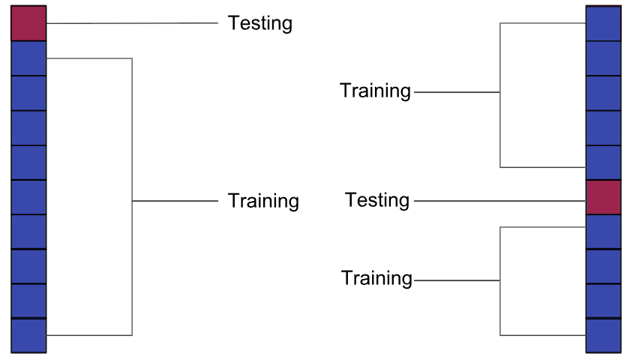
Data Splitting
Training Data
Testing Data
Untrained Model
Trained Model
Classifications
10-fold Cross Validation
9 partitions are used as training; 1 partition is used as testing
Batch-size: size of data inputted
Epochs: Iterations of data inputted

Slide 9
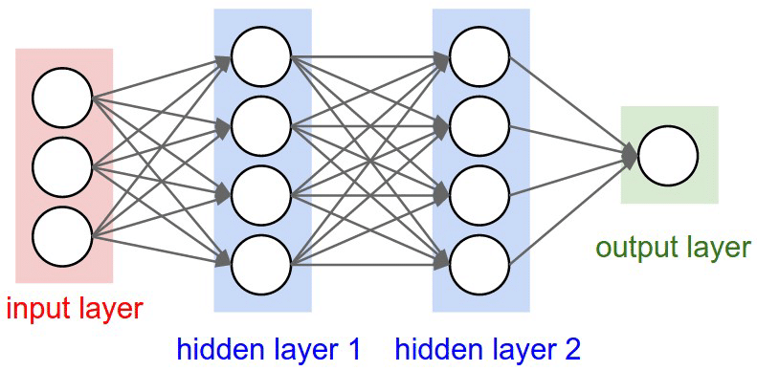
Neural Networks
Training Data
Testing Data
Untrained Model
Trained Model
Classifications
Computing systems designed to mimic the way the brain thinks
Structure: nodes and layers (input, hidden, output)

Slide 10

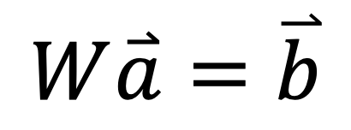
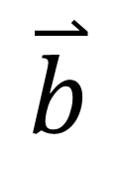

Passing Data Between Layers
Training Data
Testing Data
$$\overset{⃑}{a}$$
$$\overset{⃑}{b}$$
Untrained Model
Trained Model
Classifications
a1
b₁
$$b_{1}=w_{1,1}a_{1}+…+w_{1,3}a_{3}=\overset{⃑}{w}1・\overset{⃑}{a}$$
a₁
b1
a2
b₂
$$b_{2}=w_{2,1}a_{1}+…+w_{2,3}a_{3}=\overset{⃑}{w}2・\overset{⃑}{a}$$
$$W$$
$$W\overset{⃑}{a}=\overset{⃑}{b}$$
a₂
b2
a3
b₃
$$b_{3}=w_{3,1}a_{1}+…+w_{3,3}a_{3}=\overset{⃑}{w}3・\overset{⃑}{a}$$
a₃
b3
a4
b₄
$$b_{4}=w_{4,1}a_{1}+…+w_{4,3}a_{3}=\overset{⃑}{w}4・\overset{⃑}{a}$$

Slide 11
Cost Function
Training Data
Testing Data
Untrained Model
Trained Model
Classifications
Model trains by minimizing a Cost Function
Measurement of error
Binary Cross-Entropy: default cost function for classification problems

Slide 12
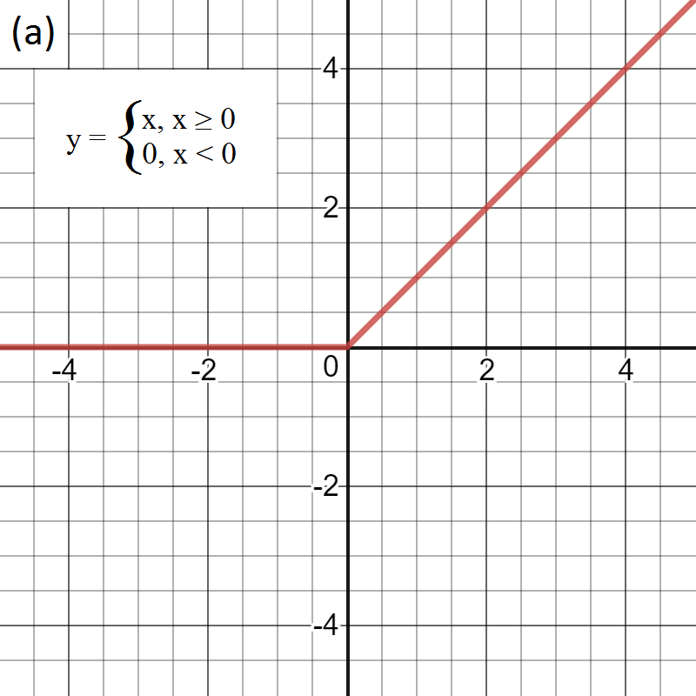
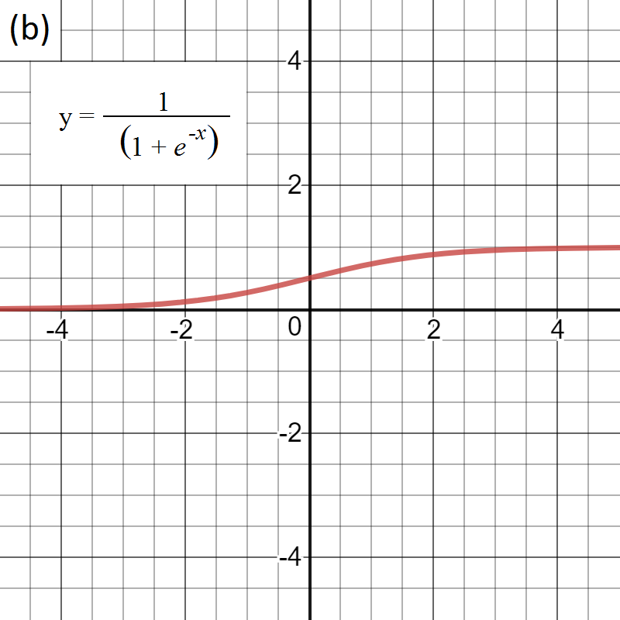
Activation Functions
Training Data
Testing Data
Untrained Model
Trained Model
Classifications
Creates nonlinear relationships by transforming data
Rectified Linear Unit (ReLU): commonly used in hidden layers
Sigmoid: default function for output layers in binary classification
ReLU
Sigmoid

Slide 13
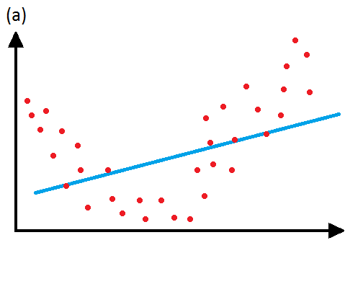
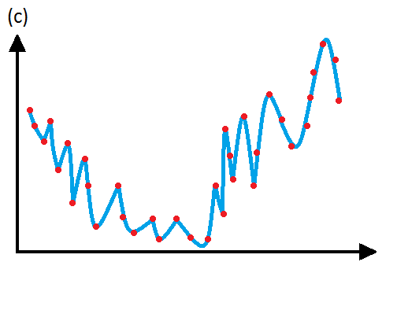
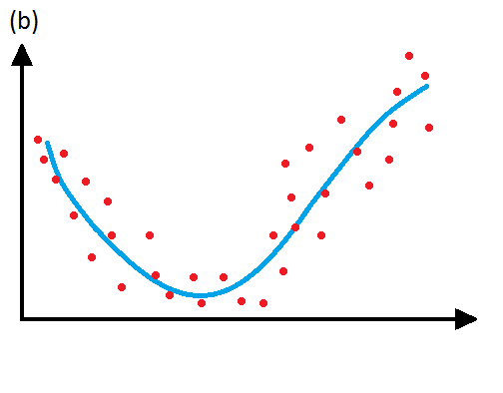
Under and Overfitting
Training Data
Testing Data
Untrained Model
Trained Model
Classifications
Underfitting: a model is not complex enough and does not fit the data well
Overfitting: model is too complex, misses general trend
Regularization: adds term to cost function to avoid complex models
Cost_{reg} = Cost + λ*(Regularization Term)
Underfit
Overfit
Good fit

Slide 14
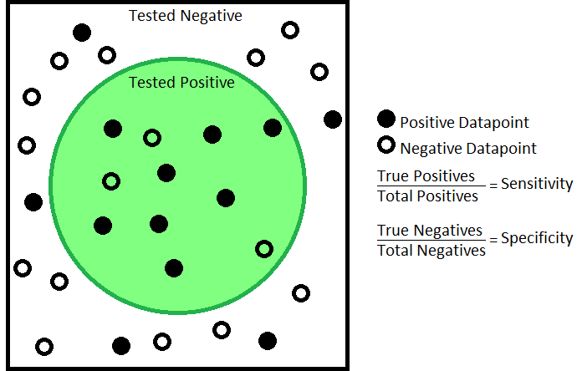
Sensitivity and Specificity
Training Data
Testing Data
Untrained Model
Trained Model
Classifications
Statistical measurements of performance
Sensitivity: true positive rate
Specificity: true negative rate
Cancer Positive
Cancer Negative
8/13 = 61.54%
13/16 = 81.25%

Slide 15
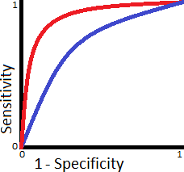
Receiver Operating Characteristic (ROC) Curves
Training Data
Testing Data
Untrained Model
Trained Model
Classifications
Parametric graph: true positive rate vs false positive rate
Models with larger area under the curve, can have their thresholds adjusted to increase specificity without significant sacrifice of sensitivity
Model 1
Model 2
True Positive Rate
False Positive Rate

Slide 16

Cancer Detecting Neural Network (CDNN)
Used same dataset as CancerSEEK
Able to detect nonlinear relationships

Slide 17
CDNN Construction
Initial Hyperparameters
CDNN
Adjust Threshold
Final Model
Improvement in Accuracy/ ROC?
No
Yes
Adjust Hyperparameters

Slide 18
Initial Hyperparameters
Initial Hyper-parameters
CDNN
Improv-ement in Accuracy/ AUC?
Adjust Threshold
Final Model
Adjust Hyper-parameters
3 layer neural network: 1 input, 1 hidden, 1 output
Hidden layer: 5 nodes, λ = 0
Batch-size: 32
Epochs: 80
Threshold: 0.5

Slide 19
Training and Testing
Initial Hyper-parameters
CDNN
Improv-ement in Accuracy/ ROC?
Adjust Threshold
Final Model
Adjust Hyper-parameters
Training Data
Testing Data
Untrained Model
Trained Model
Classifications

Slide 20
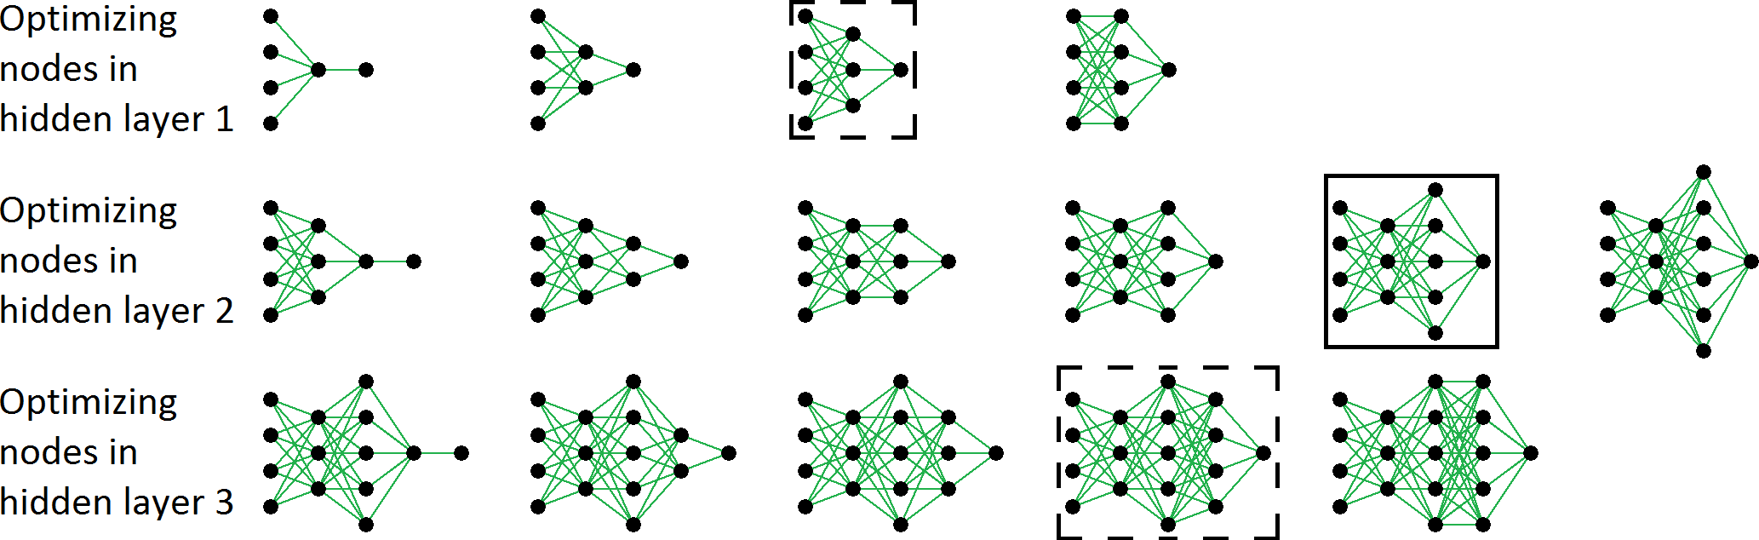
Adjusting Hyperparameters
Initial Hyper-parameters
CDNN
Improv-ement in Accuracy/ ROC?
Adjust Threshold
Final Model
Adjust Hyper-parameters
Grid Search: hyperparameter optimization method
start with small hyperparameter value
gradually increase until performance stops improving significantly
50%
62%
71%
69%
70%
75%
86%
90%
95%
92%
78%
82%
85%
89%
88%

Slide 21
CDNN Accuracy Optimization
Initial Hyper-parameters
CDNN
Improv-ement in Accuracy/ ROC?
Adjust Threshold
Final Model
Adjust Hyper-parameters
 | CDNN | CancerSEEK | Difference
Median Accuracy | 95.58% | 70.80% | 24.78%
Sensitivity | 91.24% | 62.29% | 28.95%
Specificity | 90.76% | 99.14% | - 8.38%

Slide 22
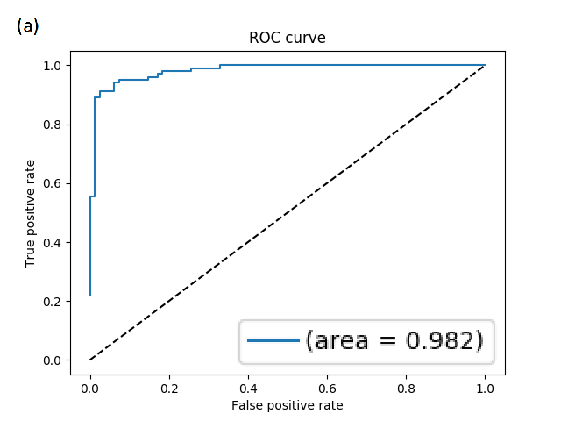
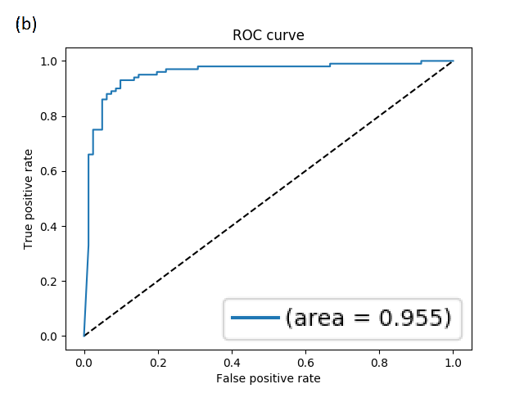
CDNN ROC Optimization
Initial Hyper-parameters
CDNN
Improv-ement in Accuracy/ ROC?
Adjust Threshold
Final Model
Adjust Hyper-parameters

Slide 23
Optimized CDNN Structure
Initial Hyper-parameters
CDNN
Improv-ement in Accuracy/ ROC?
Adjust Threshold
Final Model
Adjust Hyper-parameters
Threshold: 0.96
4 layer neural network: 1 input, 2 hidden, 1 output
Hidden layer 1: 30 nodes, λ = 0
Hidden layer 2: 25 nodes, λ = 5x10⁻⁴
Batch-size: 32
Epochs: 150

Slide 24
CDNN vs CancerSEEK
Initial Hyper-parameters
CDNN
Improv-ement in Accuracy/ ROC?
Adjust Threshold
Final Model
Adjust Hyper-parameters
 | CDNN | CancerSEEK | Difference
Mean Accuracy | 85.64% | 78.76% | 6.88%
Median Accuracy | 82.30% | 70.80% | 12.50%
Sensitivity | 74.83% | 62.29% | 12.54%
Specificity | 99.01% | 99.14% | - 0.13%

Slide 25
Individual Cancer Comparison
Initial Hyper-parameters
CDNN
Improv-ement in Accuracy/ ROC?
Adjust Threshold
Final Model
Adjust Hyper-parameters
 | CDNN Accuracy | CancerSEEK Accuracy | Difference
Lung | 83.65% | 58.65% | 25.00%
Breast | 52.63% | 33.49% | 19.14%
Esophagus/Stomach | 82.30% | 70.80% | 11.50%
Colorectum | 76.29% | 64.95% | 11.34%
Liver | 100.00% | 97.73% | 2.27%
Pancreas | 74.19% | 72.04% | 2.15%
Ovary | 98.15% | 98.15% | 0.00%

Slide 26
Conclusions and Future Work
CDNN matched or outperformed CancerSEEK.
Some cancer types exhibited more nonlinear relationships.
Using a different model for each cancer type may improve performance.
Expand CDNN for multiclass classification to locate cancer.

Slide 27
Acknowledgements
TN Junior Science and Humanities Symposium
Bill and Joe Andress
Dr. Christopher Symons and Oak Ridge National Laboratory
Jessica Williams and Dr. Deanna Pickel
Dr. Jun Qu and Ye Sun
2018-19 ORHS Thesis Class

Slide 28
References
Worldwide cancer statistics. (2018, November 14). Retrieved from https://www.cancerresearchuk.org/health-professional/cancer-statistics/worldwide-cancer
What Is Cancer? (2015, February 9). Retrieved from https://www.cancer.gov/about-cancer/understanding/what-is-cancer
J. D. Cohen et al., Science 10.1126/science.aar3247 (2018)
Survival Rates for Colorectal Cancer, by Stage. (2018, July 9). Retrieved from https://www.cancer.org/cancer/colon-rectal-cancer/detection-diagnosis-staging/survival-\\rates.html
Stöppler, M. C. (2018, April 10). Screening Tests for Cancer: Facts on Early Cancer Detection. Retrieved from https://www.medicinenet.com/cancer\_detection/article.htm\#cancer\_screening\_test\_facts
Machine Learning: What it is and why it matters. (n.d.). Retrieved from https://www.sas.com/en\_us/insights/analytics/machine-learning.html
KDnuggets. (2017, September). Retrieved from https://www.kdnuggets.com/2017/09/neural-network-foundations-explained-activation-\\function.html
Convolutional Neural Networks. (n.d.). Retrieved from http://cs231n.github.io/convolutional-networks/
Shin, D. (2017). Overfitting \& Regularization. Retrieved from http://dshincd.github.io/blog/regularization/
McDonald, C. (2017, November 27). Machine learning fundamentals (I): Cost functions and gradient descent. Retrieved from https://towardsdatascience.com/machine-learning-\\fundamentals-via-linear-regression-41a5d11f5220
Brownlee, J. (2018, May 21). A Gentle Introduction to k-fold Cross-Validation. Retrieved from https://machinelearningmastery.com/k-fold-cross-validation/
Basic Concepts and Definitions. (n.d.). Retrieved from http://gim.unmc.edu/dxtests/reviewof.htm
Schoonjans, F. (2018, November 09). ROC curve analysis with MedCalc. Retrieved from https://www.medcalc.org/manual/roc-curves.php
Cook, E., \& Lindsay, K. (2018, January 18). Single Blood Test Screens for Eight Cancer Types. Retrieved from https://www.hopkinsmedicine.org/news/newsroom/news-\\releases/single-blood-test-screens-for-eight-cancer-types

